Slide 1

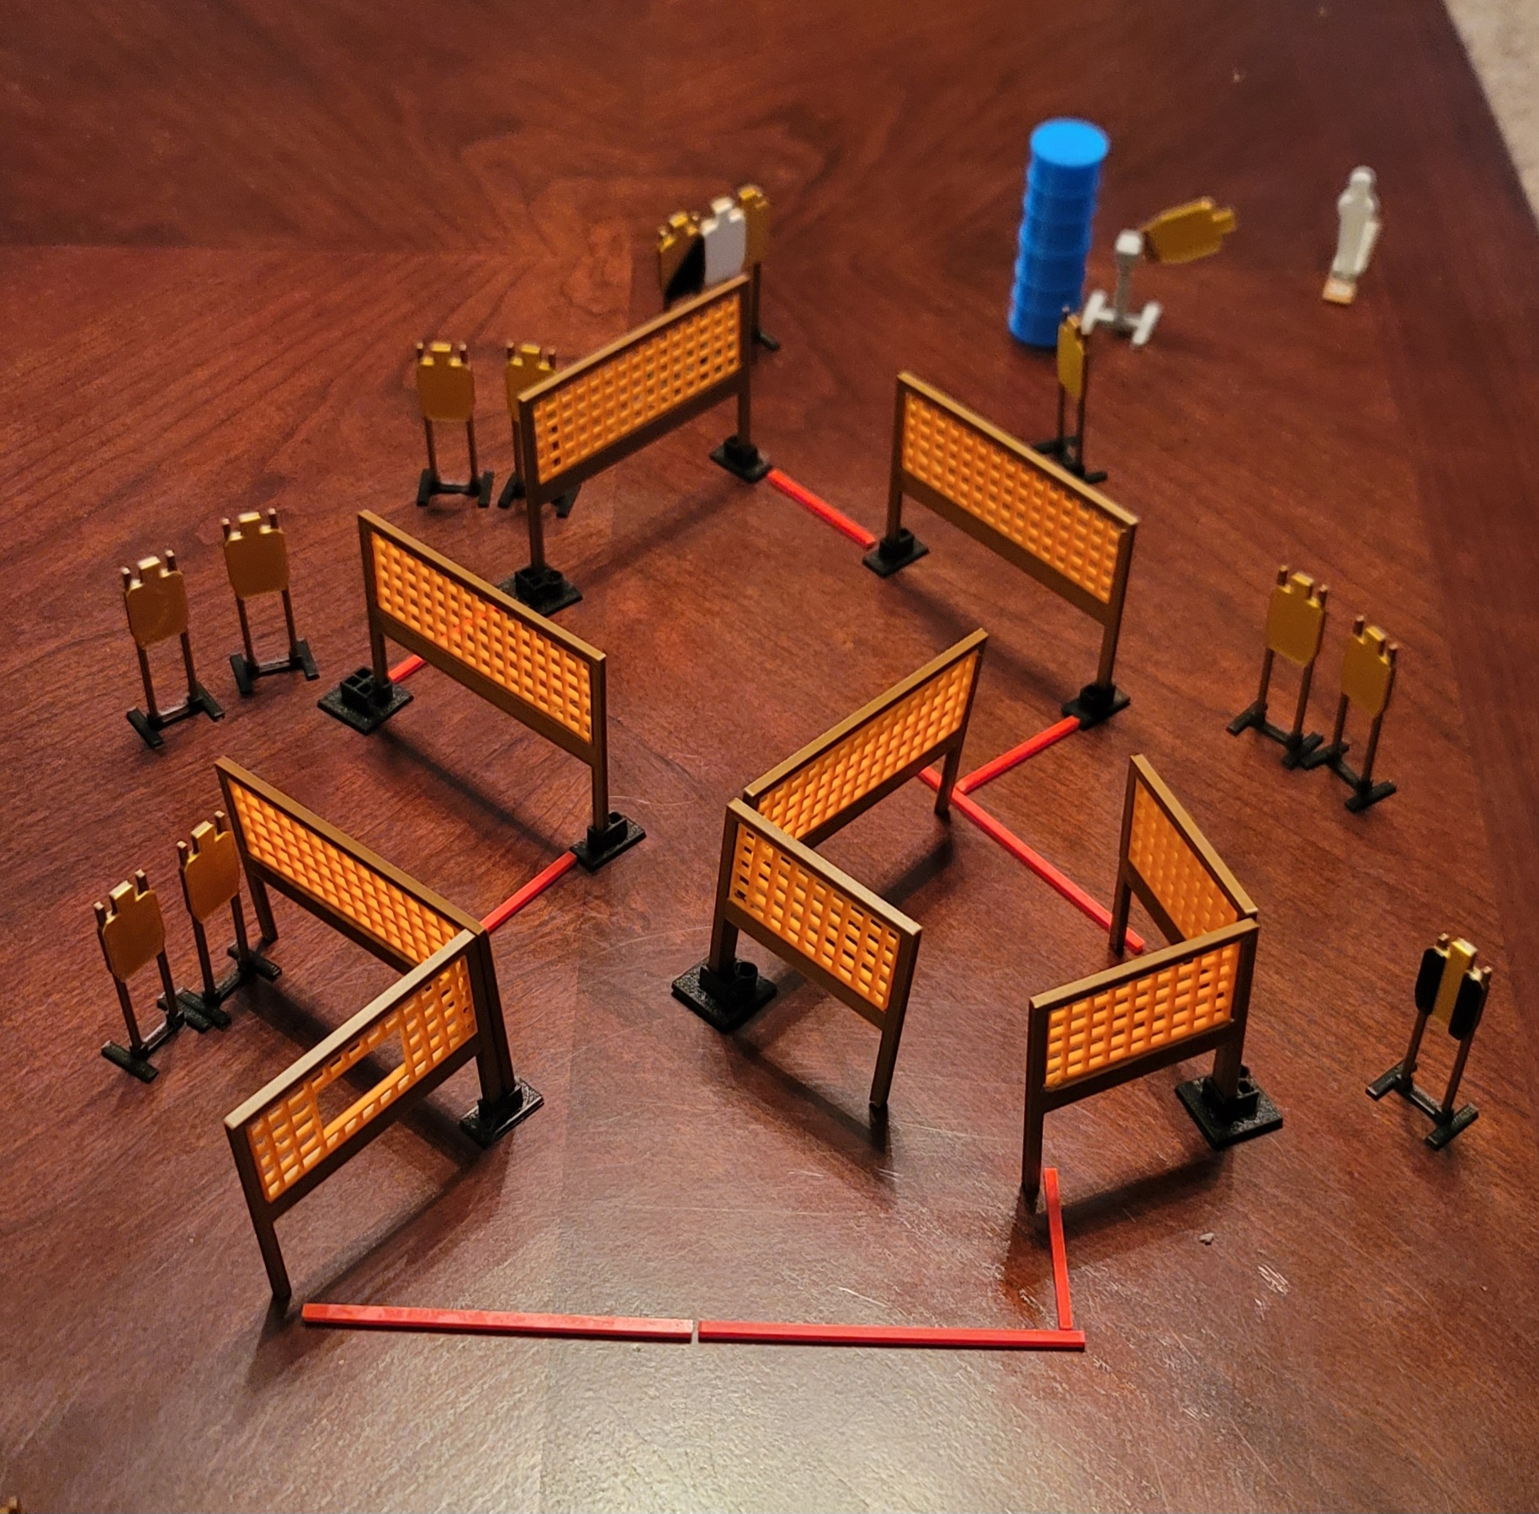
 | Dothan Practical Shooters – USPSA Match A-Maze-ing Course Designer : Eric Henwood Bay: A2
Round Count 27 rounds 13 USPSA 1 colt popper
Equipment List 15 wall feet 12 paper (11 + 1 NS) 1 tux + 1 right diag Swinger + activator

Slide 2
A-Maze-ing
Written Stage Briefing
Scoring: Comstock Rounds: 27
Targets: Comstock
Handgun start position: hands touching marks, loaded and holstered.
PCC start position: muzzle touching either mark, stock on belt. Loaded carbine is held with both hands, safety on.
Stage Procedure: on the audible start signal, engage targets as they become available from within the shooting area. The swinger is activated by P1 and remains visible at rest.

